Slide 1
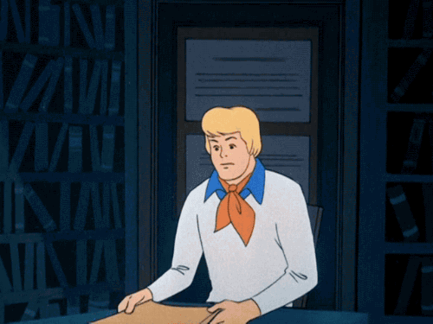
I have no idea!

Slide 2
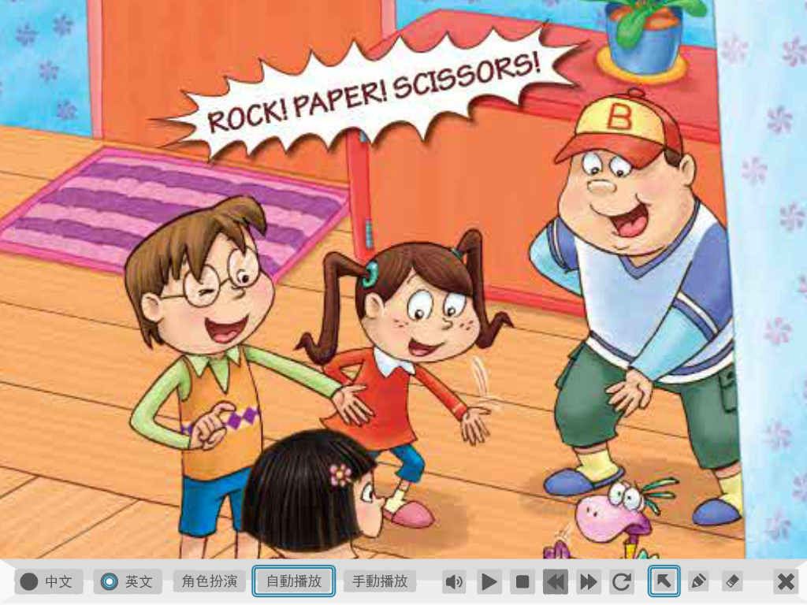
Paper! Scissors!
Stone!

Slide 3
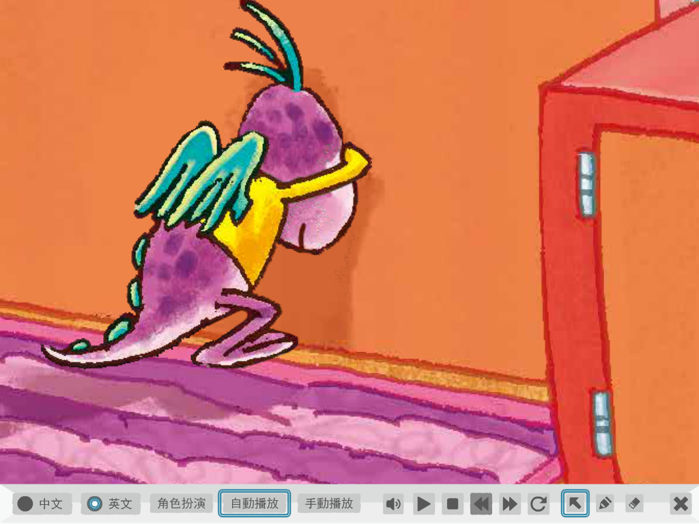
Dino is counting.

Slide 4
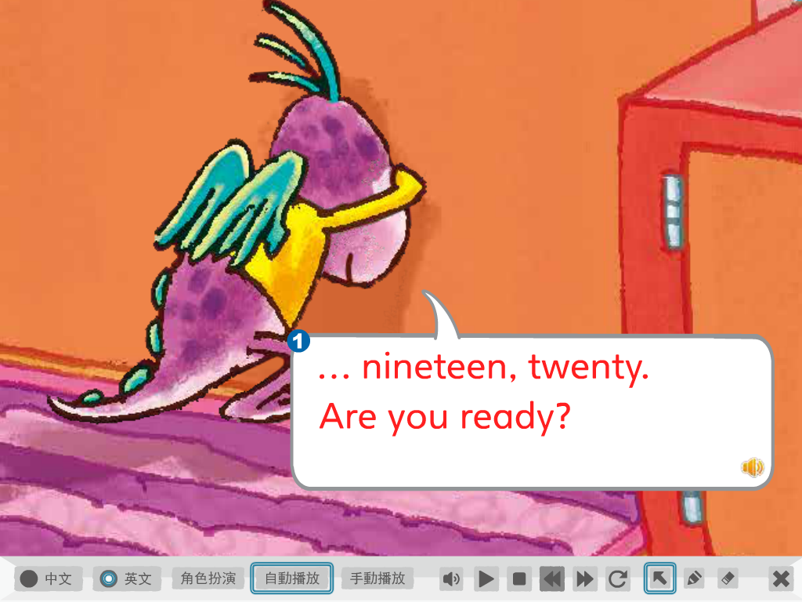

Slide 5
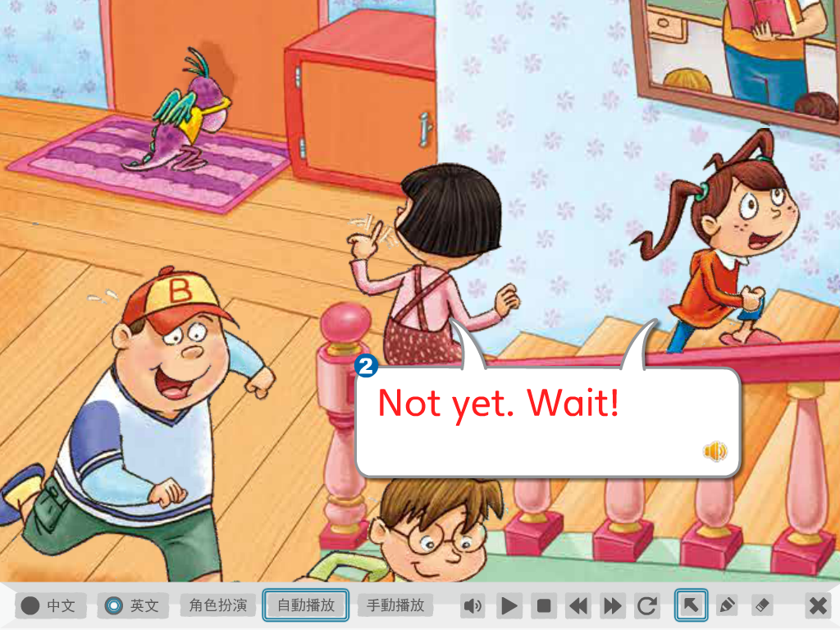
還沒

Slide 6
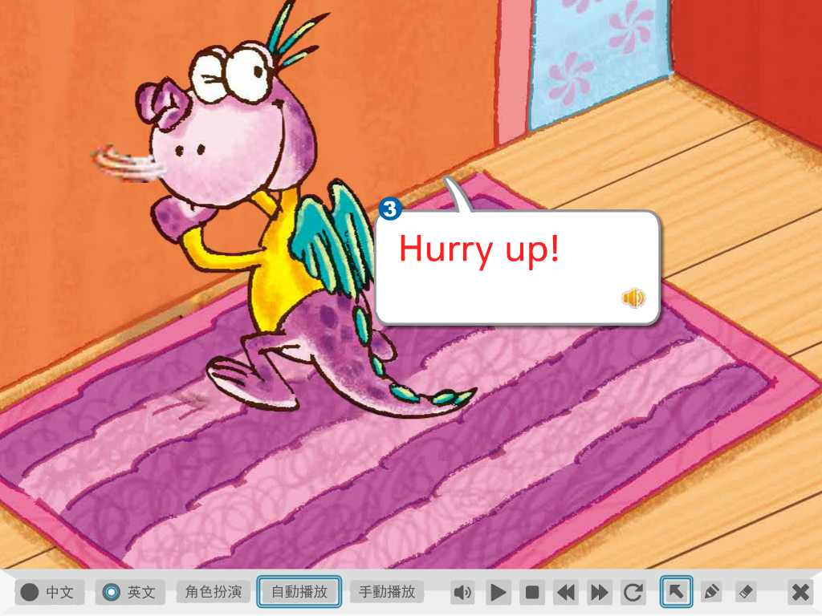
Be quick!

Slide 7
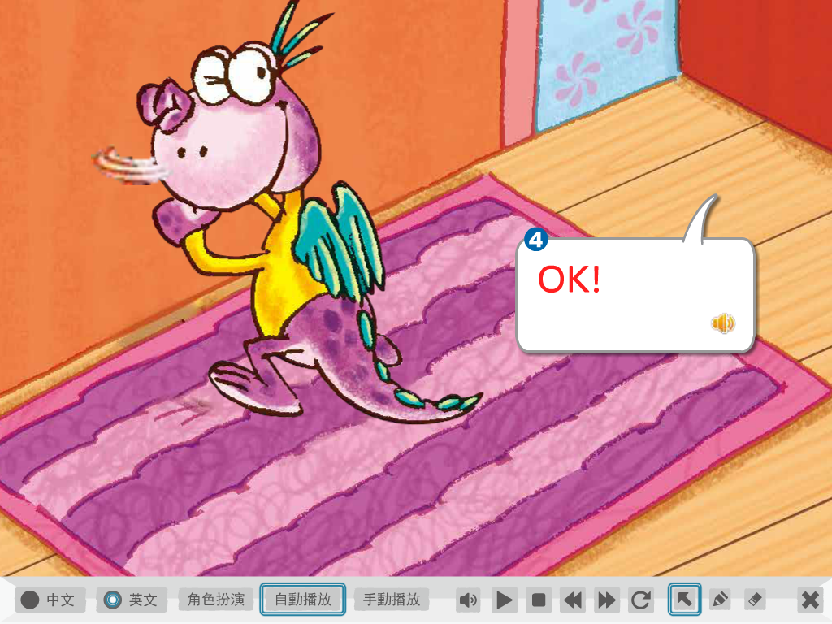
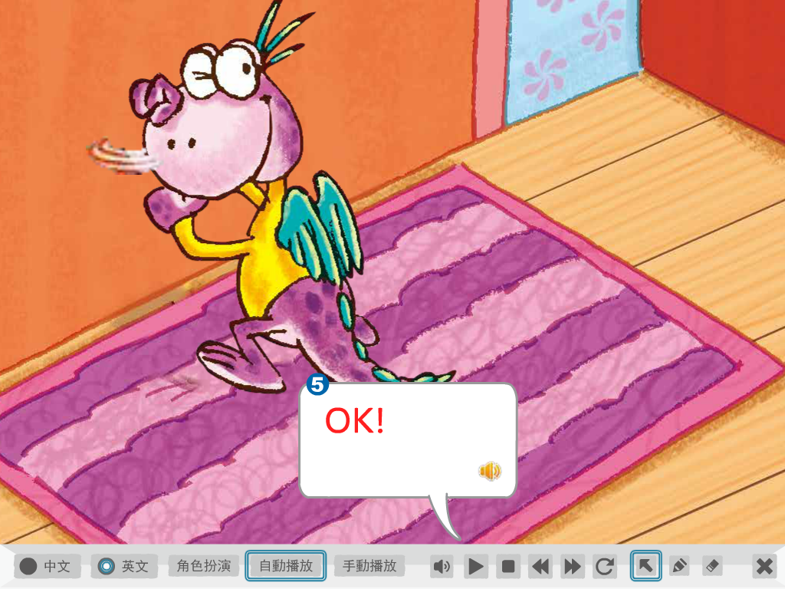

Slide 8
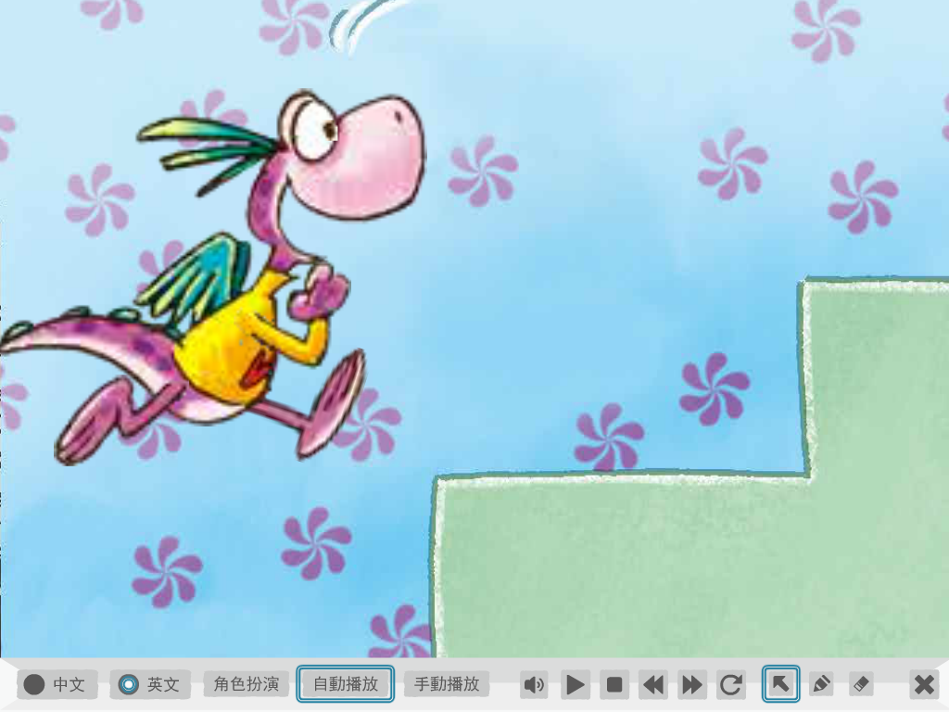
Dino is climbing up the stairs.

Slide 9
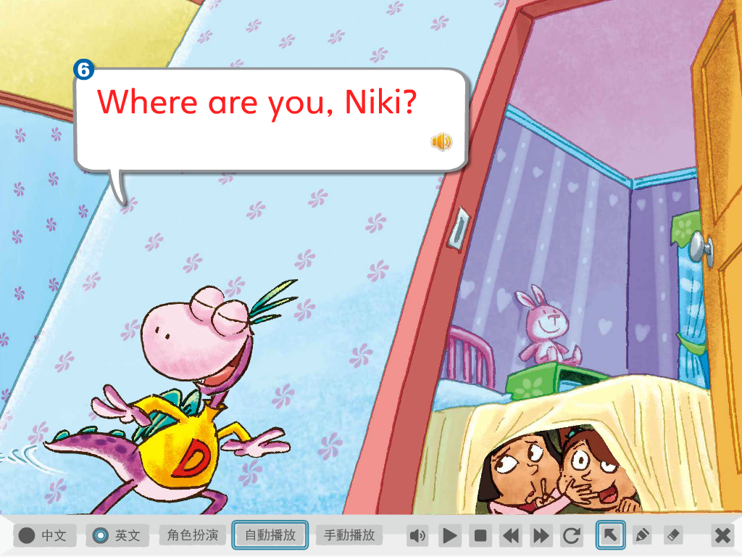

Slide 10
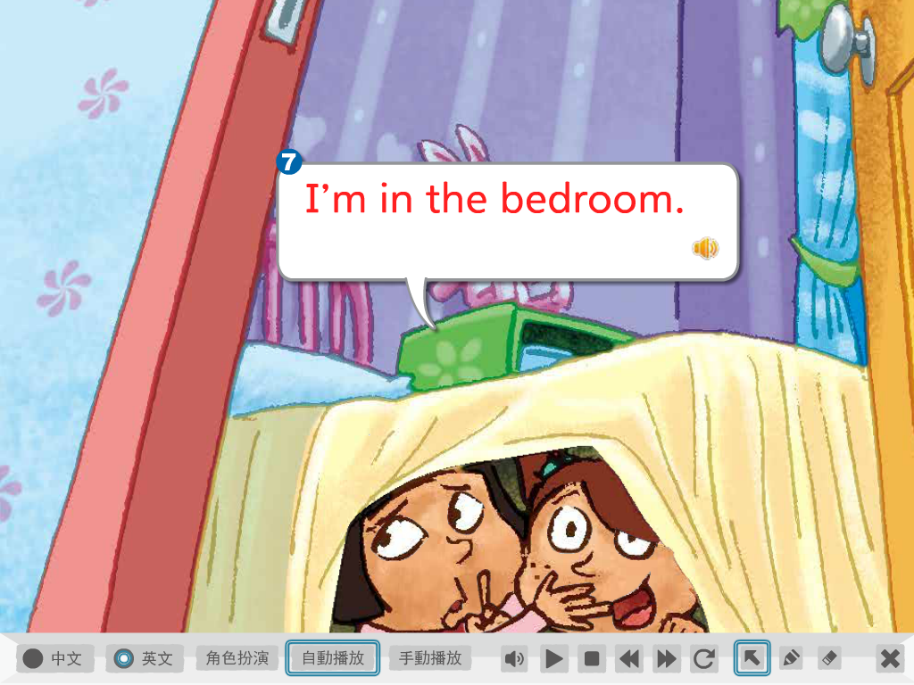

Slide 11
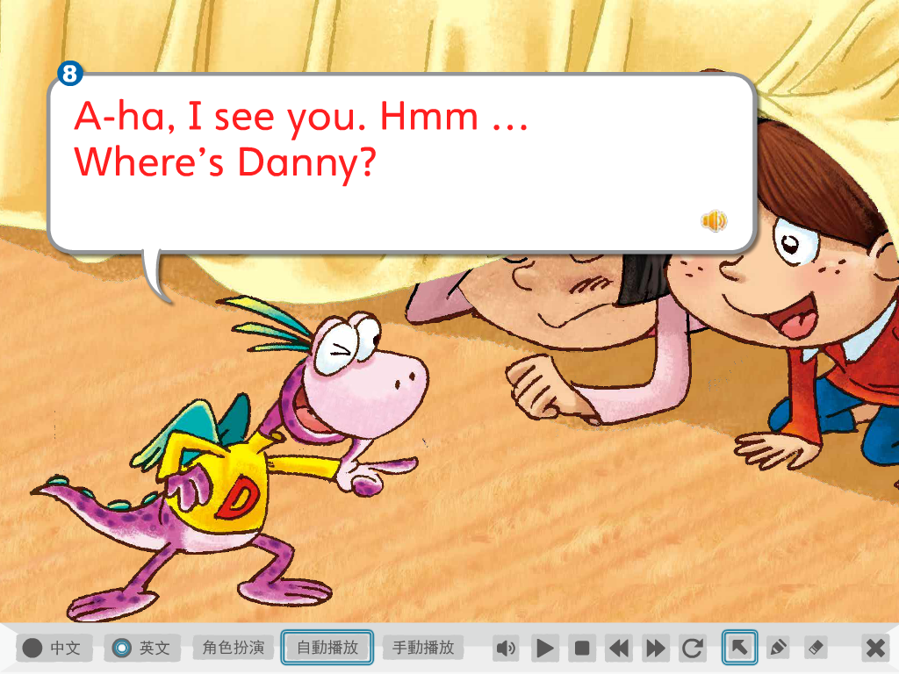
嗯…

Slide 13
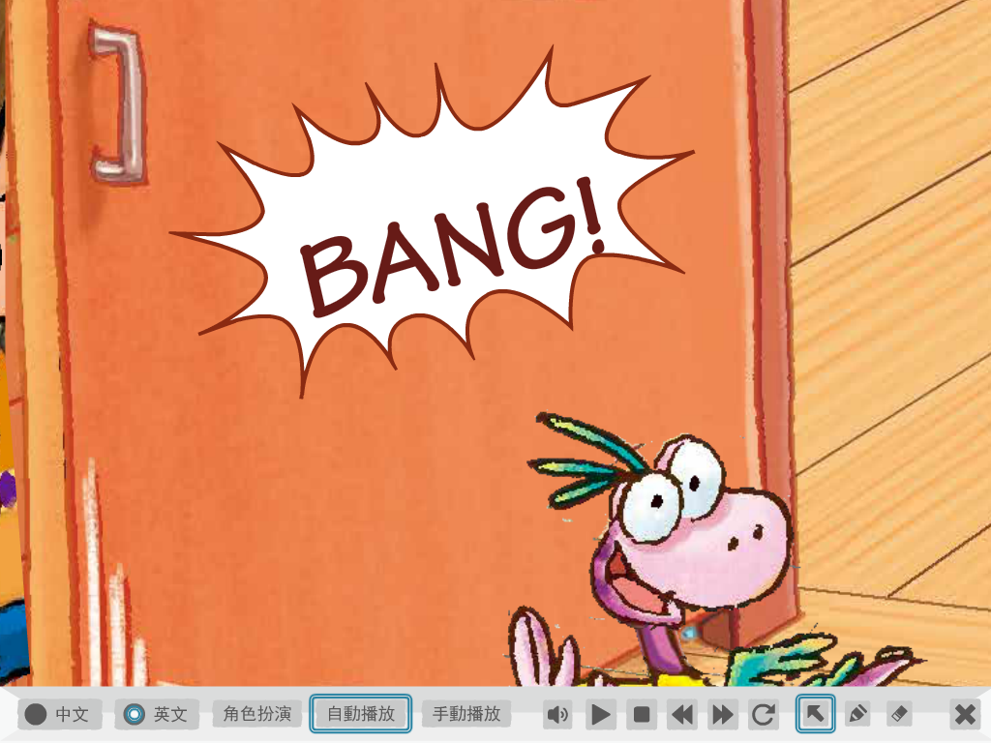
砰!!

Slide 14
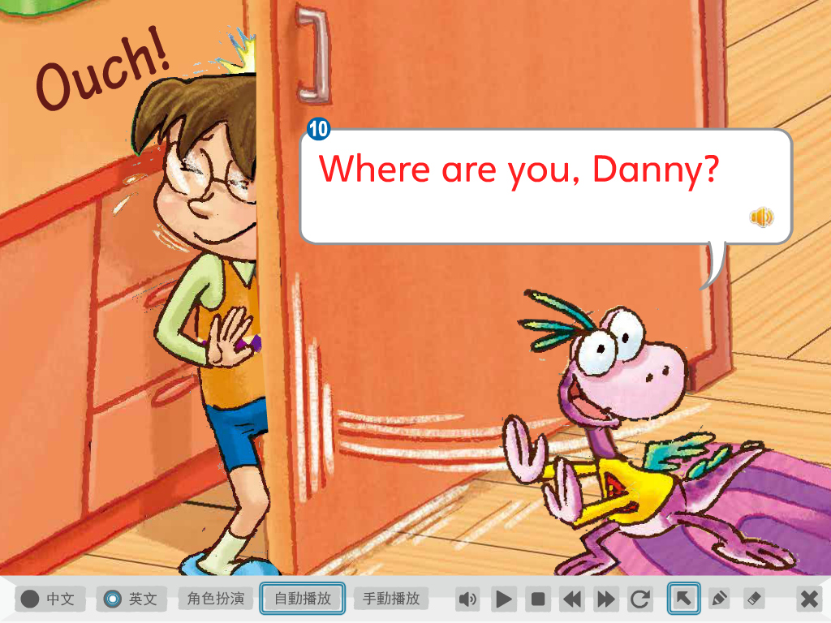

Slide 15
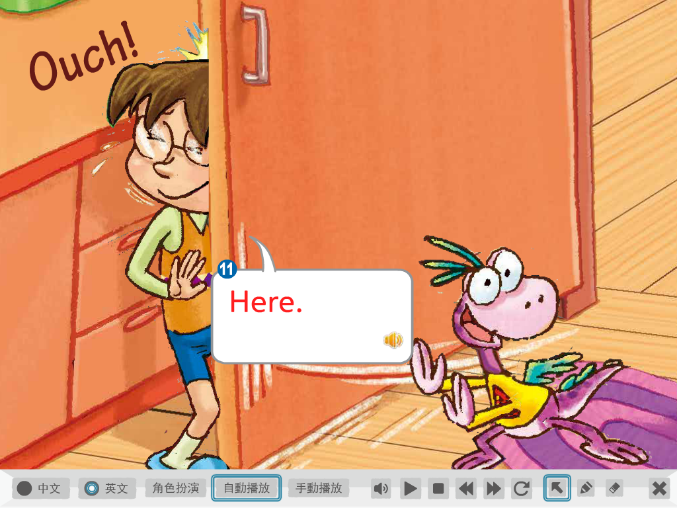

Slide 16
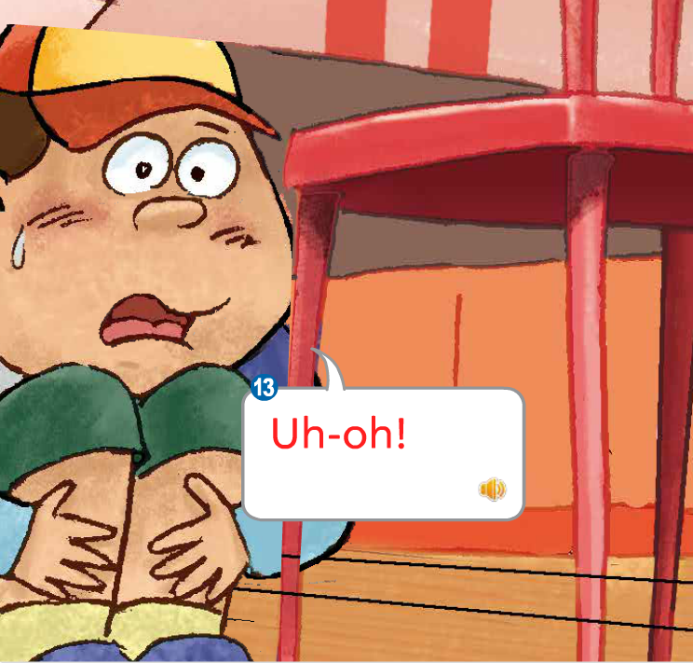
哎呦!

Slide 17
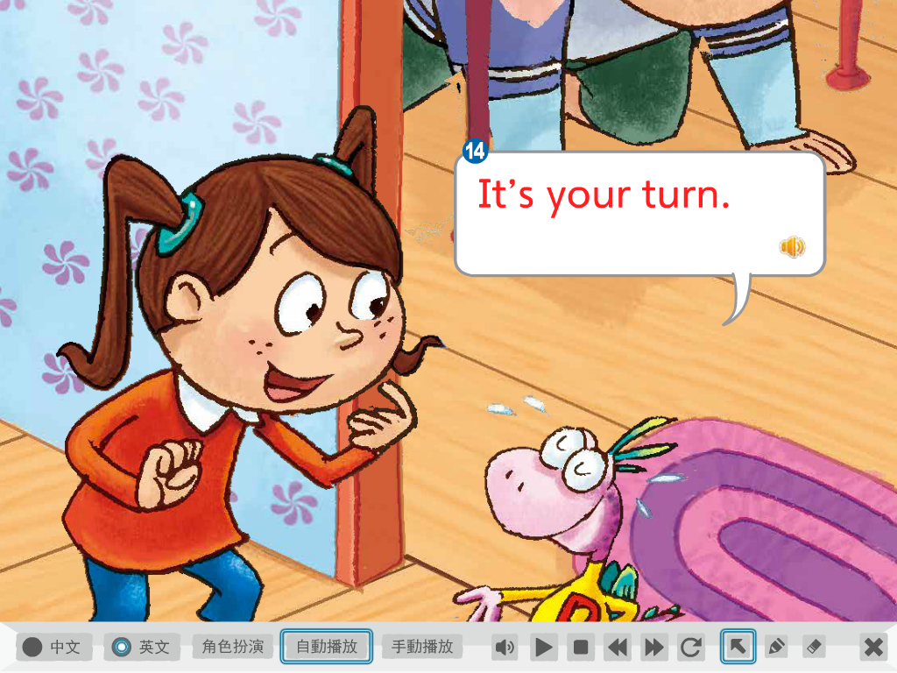
輪到你當鬼了

Slide 18
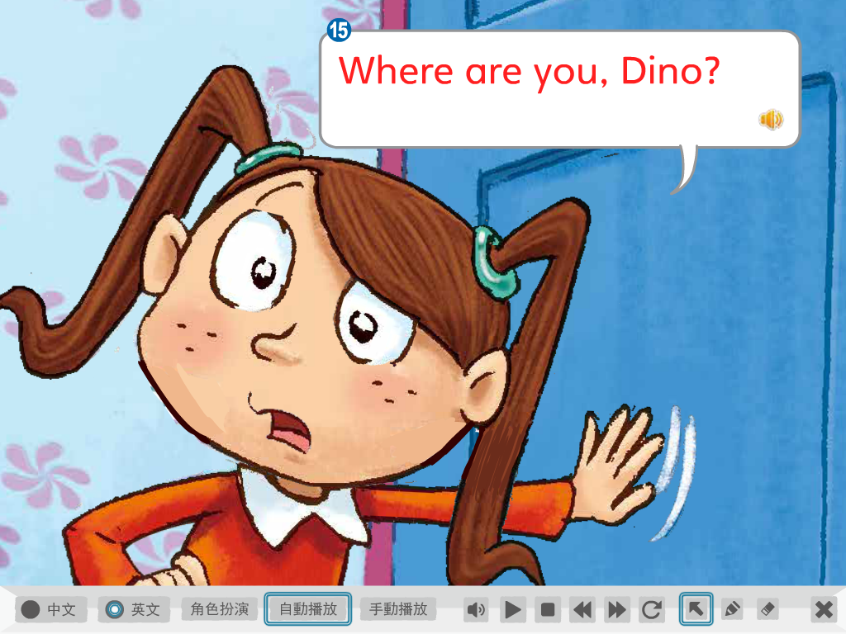

Slide 19
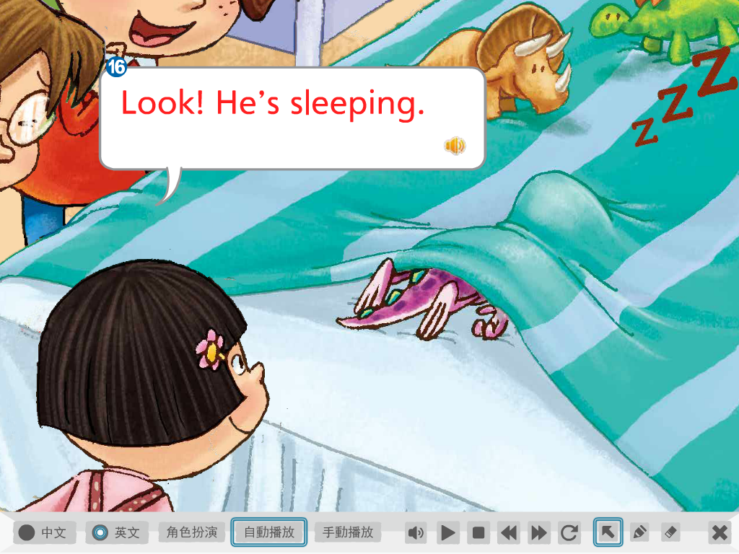
Snore打呼

Slide 20
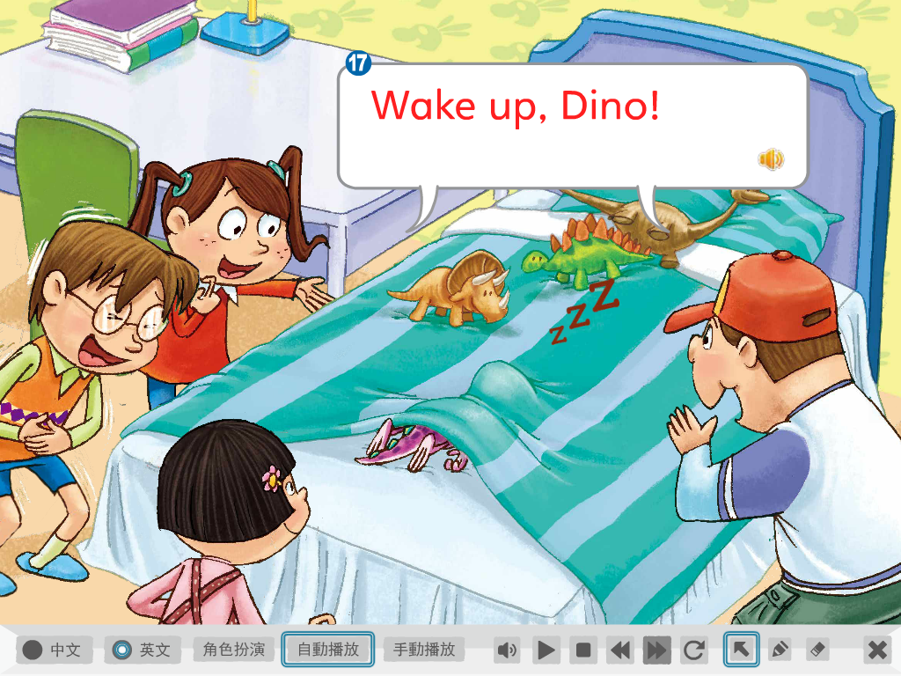

Slide 21
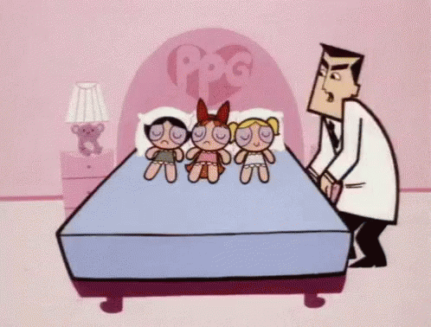
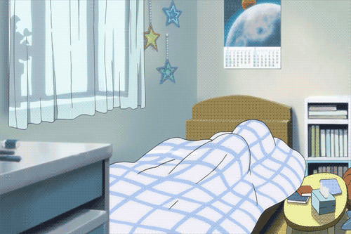
Daily Talk
Wake up!
Get up!
Rise and shine!

Slide 22
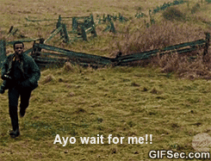
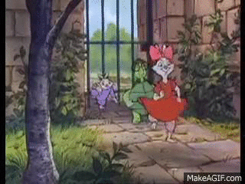
Daily Talk
Wait!

Slide 23
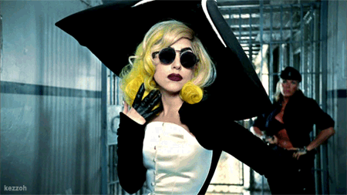

Slide 24
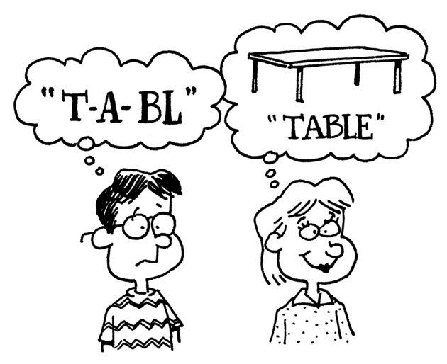
Phonics Time p50~51

Slide 25
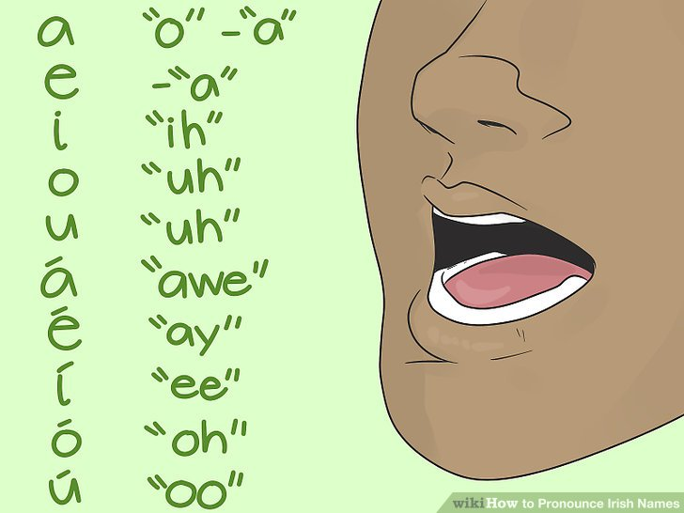
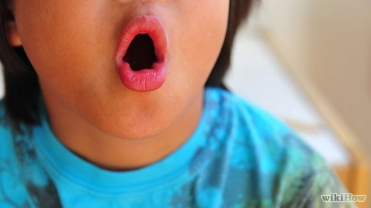
o
o
e

Slide 26
o

Slide 27
n
t
o

Slide 28
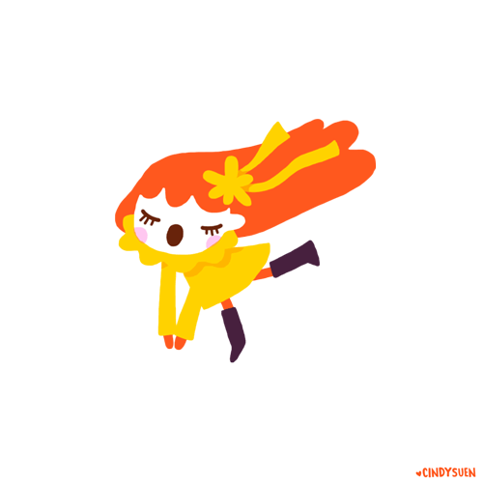
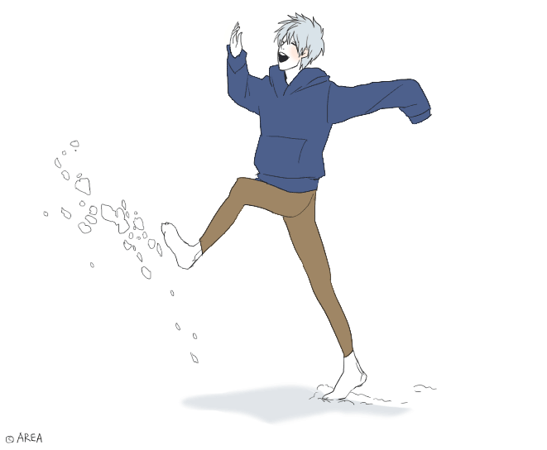
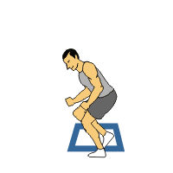
h
p
o

Slide 29
o
e

Slide 30
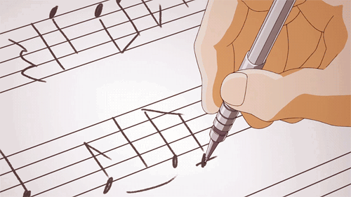
n
t
o
e

Slide 31
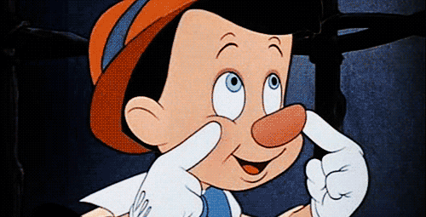
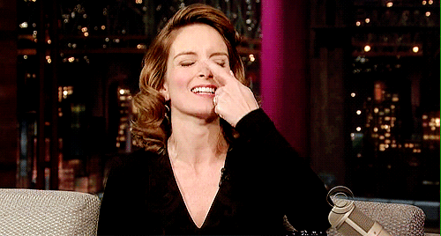
n
s
o
e

Slide 32
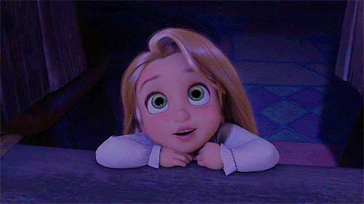
h
p
o
e

Slide 33
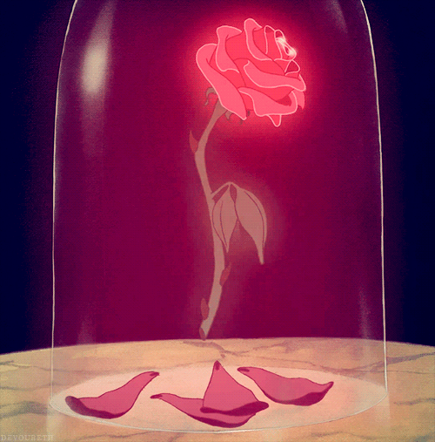
r
s
o
e

Slide 34
Tom can hop.
Bell cannot.
Tom hops to a rose.
He smells it with his nose.

Slide 35
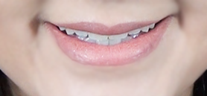
a
a
e

Slide 36
a

Slide 37
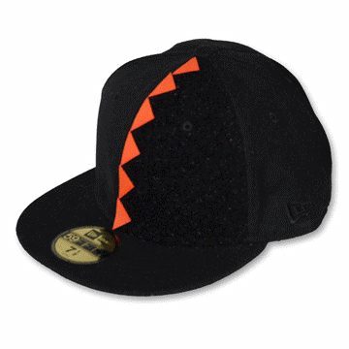
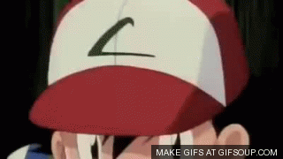
c
p
a

Slide 38
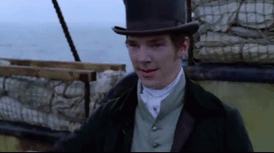
h
t
a

Slide 39
a
e

Slide 40
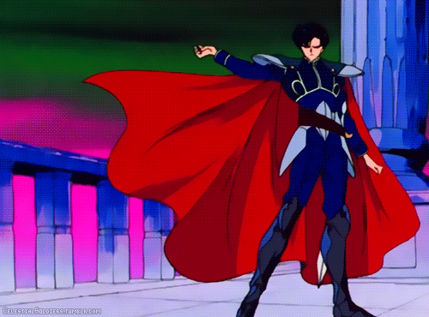
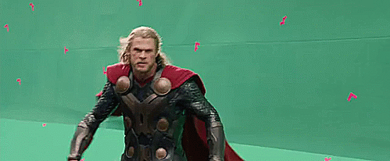
c
p
a
e

Slide 41
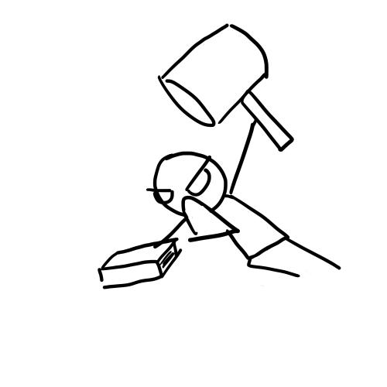
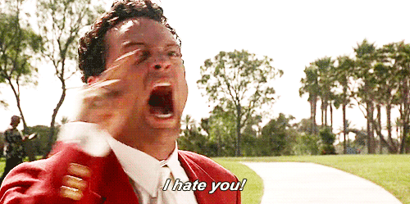
h
t
a
e

Slide 42
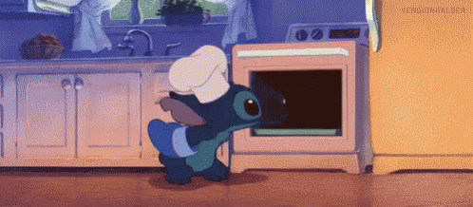
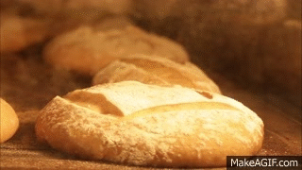
b
k
a
e

Slide 43
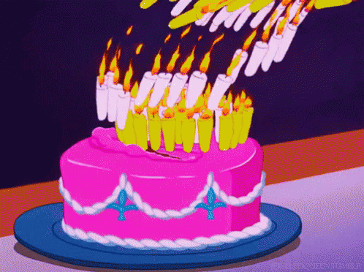
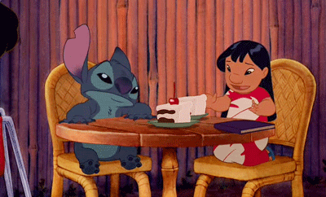
c
k
a
e

Slide 44
This is a cape.
That is a hat.
I like the cape.
I hate the hat.

Slide 45
e
e
e

Slide 46
e

Slide 47
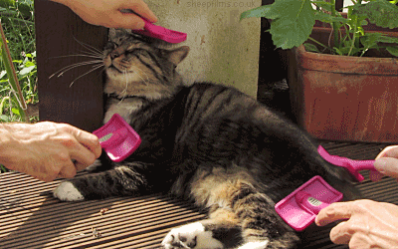
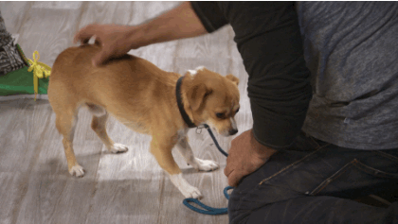
p
t
e

Slide 48
n
t
e

Slide 49
e
e

Slide 50
P
t
e
e

Slide 51
v
E
e

Slide 52
Chin
s
e
e

Slide 53
He is Pete.
Pete has a pet.
She is Eve.
Eve has a net.
Pete and Eve can speak Chinese of pet and net.

Slide 54
i
i
e

Slide 55
i

Slide 56
k
t
i

Slide 57
p
p
i

Slide 58
i
e

Slide 59
k
t
i
e

Slide 60
p
p
i
e

Slide 61
h
k
i
e

Slide 62
r
d
i
e

Slide 63
Hike with a kit.

Slide 64
Ride with a kite.

Slide 65
Let’s hike and ride a bike.

Slide 66
Hike with a kit.
Ride with a kite.
Let’s hike and ride a bike.

Slide 69
【第十四週英語作業】
1. 課本P52頁內容，請家長協助認證簽名。
2.寫:完成英語習寫簿上黏貼的學習單，下週一交。

Slide 70
a
a
e
e
e
e
i
i
e
o
o
e

